Slide 1


Brent Carcamo
09-06-2023

Slide 2

Outline
Executive Summary
Introduction
Methodology
Results
Conclusion
Appendix

Slide 3
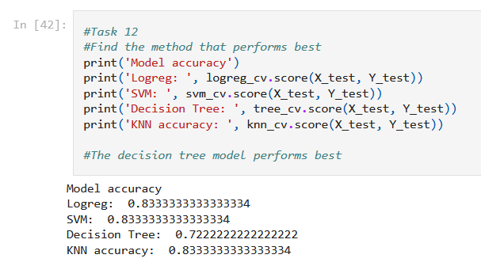
Executive Summary
Methodology
In this project, I trained four different machine learning models to predict whether the first stage of the Falcon 9 SpaceX rocket will successfully land. Each of the (4) models were optimized using a range of hyperparameters; I then compared the accuracy of each model to find the most useful model.
The four classification algorithms I tested:
Logistic Regression
Support Vector Machines
Decision Tree Classifier
K-Nearest Neighbors
Results
I found that the best model in terms of accuracy was tied between Logistic Regression, SVM, and KNN. The Decision Tree classifier model seemed to be significantly less accurate than the other three models, and therefore the least useful.

Slide 4
Introduction
Project background and context
SpaceX is able to launch rockets relatively inexpensively compared to other competitors in the industry. This is because their Falcon 9 rocket can be reused if it lands without crashing during the first stage. It doesn’t always land successfully, but sometimes it does. If we can predict whether a SpaceX rocket with land successfully, we can better understand SpaceX’s estimated costs, and, in turn, how much to bid against them. The goal of this project is to develop and train a machine learning model that can determine if the first stage of SpaceX’s Falcon 9 rocket will land successfully.
Key questions
What are the key independent variables that determine whether SpaceX will reuse the first stage?
Which machine learning models work best for predicting whether the first stage will land successfully?
Do some launch sites have greater success rates than others?

Slide 5

Section 1

Slide 6
Methodology
Executive Summary
Data collection methodology
Perform data wrangling
Perform exploratory data analysis (EDA) using visualization and SQL
Perform interactive visual analytics using Folium and Plotly Dash
Perform predictive analysis using classification models

Slide 7
Data Collection
SpaceX API Request
The first way I collected data was through the publicly available SpaceX API. The SpaceX API contains historical launch data with key independent variables needed to train my machine learning model.
The API was called via the requests library through a GET request. The API returned a JSON file, which I parsed and read into a Pandas DataFrame for further analysis.
Web Scraping Wiki Page
Data was also collected via web scraping a wiki page using the Beautiful Soup library and the requests library. The requests library was used to scrape rocket launch data from the wiki page, specifically the launch tables. I then used the Beautiful Soup library to parse through the HTML and load the data into my Pandas DataFrame.

Slide 8
Data Collection – SpaceX API
Flowchart
I used the GET requests to request and parse the SpaceX API, which responds with a JSON file. I then used the pandas json_normalize() method on the JSON response, and read it into a Pandas DataFrame.
GitHub URL: https://github.com/bcarcamo91/IBM-Capstone/blob/0f5a66cd85d5cd0dbea9dd9e80bf08da5b0d716a/F9%20Data%20Collection%20W1.ipynb
GET request
Client
SpaceX API
JSON response

Slide 9
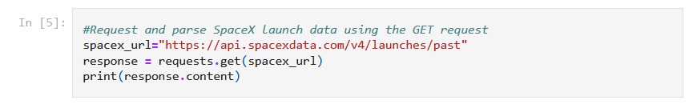
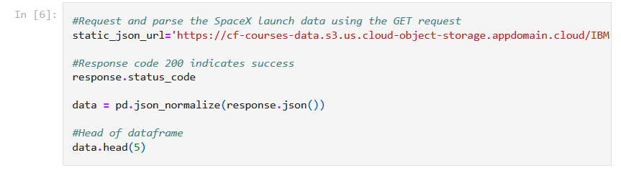
Data Collection – SpaceX API cont.

Slide 10
Data Collection - Scraping
Flowchart
I used the requests library to get a response from the wiki URL containing the historical rocket launch data, and then used Beautiful Soup to parse it. I created a Beautiful Soup object and used various methods (such as the .find(‘title’)) method to extract the data I needed.
GitHub URL: https://github.com/bcarcamo91/IBM-Capstone/blob/main/F9%20Web%20Scraping%20W1.ipynb
GET request
Client
Wiki Page
JSON response
Parse launch HTML tables
Beautiful Soup Object

Slide 11
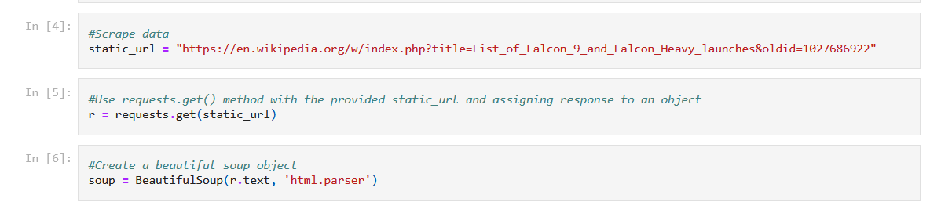
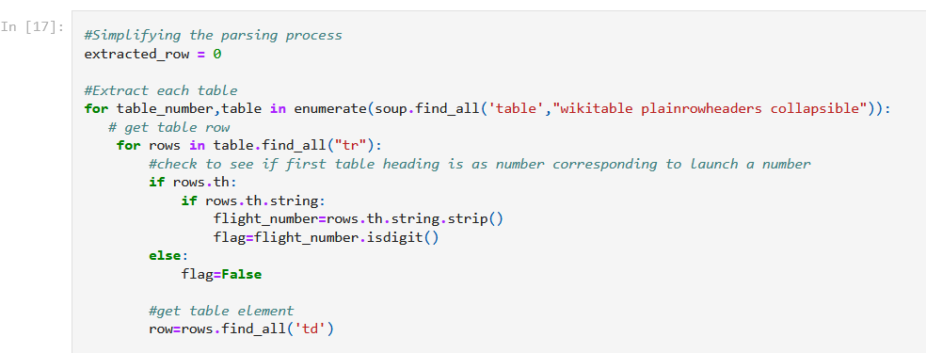
Data Collection – Scraping cont.

Slide 12
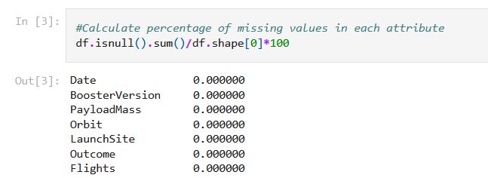
Data Wrangling
Data was first loaded into a Pandas DataFrame
Calculated the percentage of missing values in each attribute

Slide 13
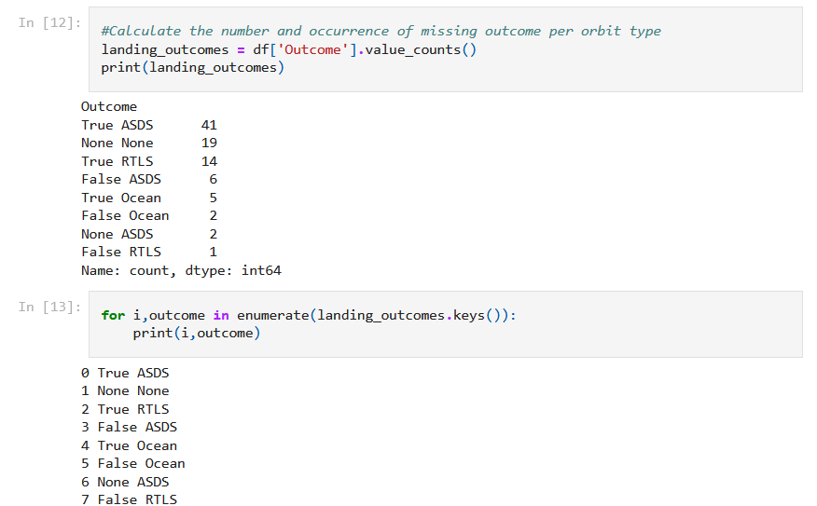
Data Wrangling cont.
3. I then used the value_counts() method to calculate the number of launches on each site. 4. Afterward, I calculated the number and occurrence of each orbit using the same value_counts() method.
5. Next, I calculated the number and occurrence of missing outcome per orbit type, and created a set of outcomes where the second stage did not land successfully.

Slide 14
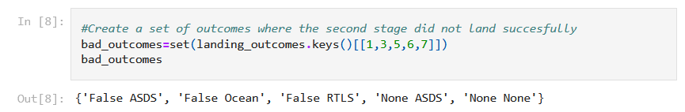
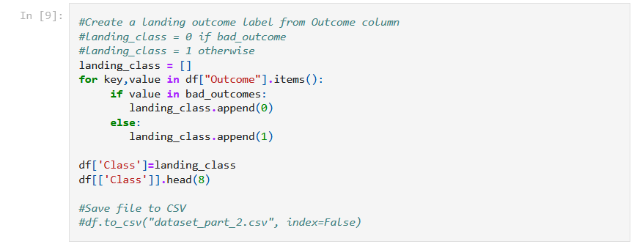
Data Wrangling cont.
6. Finally, I created a landing outcome label from the Outcome column. This is the independent I used for the machine learning models.
GitHub URL: https://github.com/bcarcamo91/IBM-Capstone/blob/0f5a66cd85d5cd0dbea9dd9e80bf08da5b0d716a/F9%20Data%20Wrangling%20W1.ipynb

Slide 15
EDA with Data Visualization
I tried to identify correlations and relationships between independent variables and successful landings to get a feel for the day and begin to understand which variables are strong predictor variables.
Charts included scatter plots of Payload Mass vs. Flight Number, Launch Site vs. Flight Number, Launch Site vs. Payload Mass, Orbit vs. Payload Mass, and others. I plotted a line plot to visualize the launch success yearly trend as well.
The purpose of the visualization was to get a feel for variable relationships and tendencies. The scatter chart of Launch Site vs. Flight Number showed me which launch sites had a higher percentage of successful launches. This information is useful when building the machine learning model in later stages.
Github URL: https://github.com/bcarcamo91/IBM-Capstone/blob/0f5a66cd85d5cd0dbea9dd9e80bf08da5b0d716a/F9%20Exploring%20and%20Preparing%20Data%20W2.ipynb

Slide 16
EDA with SQL
Summary of SQL queries performed
Displayed the names of the unique launch sites in the space mission to get an exhaustive list of all the possible launch sites
Displayed 5 records where launch sites begin with the string ‘CCA’
Displayed the distinct Booster Versions where launch sites begin with the string ‘CCA’
Displayed the average payload mass carried by booster version F9 v1.1
Listed the date when the first successful landing outcome in ground pad was achieved
Listed the names of the boosters which have success in drone ship and have payload mass greater than 4000 but less than 6000
Listed the total number of successful and failure mission outcomes
Listed the names of the booster versions which have carried the maximum payload mass using a subquery.
Listed the count of landing outcomes between dates covering the range of around 7 years.
Github URL: https://github.com/bcarcamo91/IBM-Capstone/blob/0f5a66cd85d5cd0dbea9dd9e80bf08da5b0d716a/F9%20SQL%20EDA%20W2.ipynb

Slide 17
Build an Interactive Map with Folium
I created a Folium map with various markers, circles, and lines that could help visualize the geographical locations of SpaceX’s launch sites. The Folium map I created included the following:
The NASA Johnson Space Center marked with a circle and marker.
All launch sites from the SpaceX dataset marked with a circle and marker. Pop up text includes the respective launch site’s name.
All successful/failed launches marked on the map in marker clusters. Successful launches are colored green, and failed launches are colored in red.
Two proximal mouse positions – a coastline coordinate and a railroad coordinate – marked on the map, with text displaying their relative distance to one of the four launch sites. Polylines displaying the distance between the launch site coordinates and the coastline/railroad coordinates were also marked on the map.
These objects were added to make it easier to identify any relationship between launch sites and likelihood of success/failure. Indeed, we were able to identify a specific launch site that had a higher likelihood of successful landings than its peer launch sites.
Github URL: https://github.com/bcarcamo91/IBM-Capstone/blob/0f5a66cd85d5cd0dbea9dd9e80bf08da5b0d716a/F9%20Launch%20Sites%20Viz%20with%20Folium%20W3.ipynb

Slide 18
Build a Dashboard with Plotly Dash
Two interactive visualizations were developed with Plotly Dash to help understand the data.
The first is a pie chart containing all launch sites and the success of each one. You can further filter the pie chart and select a specific launch site selected from a dropdown, where the pie chart will reflect the number of successful and failed launches for selected site
The second is scatter plot with Payload Mass (kg) in the x-axis and landing outcome in the y-axis. This plot is dynamic and changes based on the selected launch site from the dropdown, as well as the Payload range (kg) selected in the slider. The payload range can range from 0 to 10,000.
These visualizations help me understand which launch site had the most successful launches, as well as what effect, if any, Payload Mass (kg) may be having on the landing outcome.
Github URL: https://github.com/bcarcamo91/IBM-Capstone/blob/main/F9%20Plotly%20Interactive%20Dashboard%20W3.py

Slide 19
Predictive Analysis (Classification)
To begin the predictive analysis portion, I first loaded my data sets into variables. I stored the dependent variable ‘class’ in a series, and the independent variables in a pandas DataFrame.
I then used the StandardScaler method to standardize the data set before I prepared it to be split into testing and training sets. Once the data was standardized, I split the dependent and independent variables into testing and training sets using the train_test_split function. I set the parameter test_size = 0.2 which meant 20% of the data went to testing, and 80% went to training. The outcome of this step produced a total of four new variables.
For the predictive analysis portion, I built four different machine learning models to try to find the most useful model with the highest accuracy in predicting landing outcomes. For each model, I used GridSearchCV to find the best tuned hyperparameters for each model programmatically. The four models that I trained included the following:
Logistic Regression
Support Vector Machines
Decision Tree classifier
K-Nearest Neighbors
Github URL: https://github.com/bcarcamo91/IBM-Capstone/blob/main/F9%20Spacex%20ML%20Predictions%20W4.ipynb

Slide 20
EDA results

Slide 21
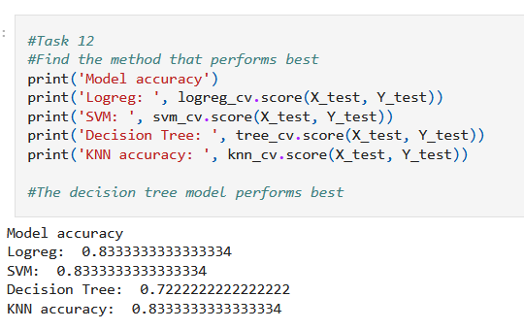
Predictive analysis results
Accuracy calculated using the .score() method
Winners

Slide 22
Predictive analysis results cont.
Once the four models were built and the best hyperparameters were found for each model, I selected the model that had the highest accuracy. Interestingly, the Decision Tree Classifier had a significant lower accuracy than the other three models. In fact, I found that Logistic Regression, Support Vector Machines, and K-Nearest Neighbors performed equally well when the accuracy was compared. Therefore, I concluded that either of the three could be used to effectively predict successful Falcon 9 rocket landings. The model to steer away from using as a predictive model is the Decision Tree classifier model, with an accuracy of 0.72.

Slide 23
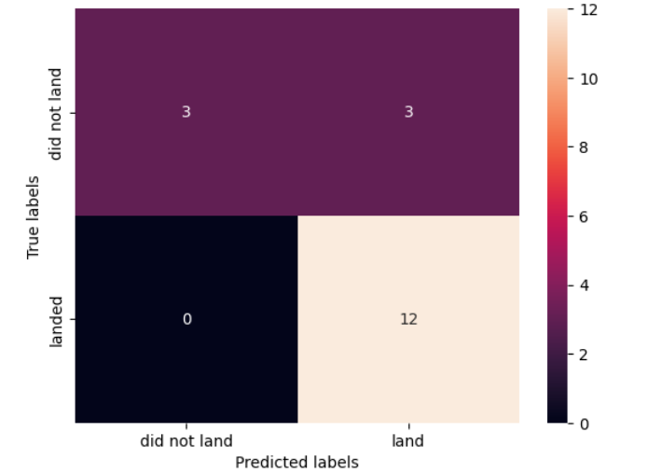
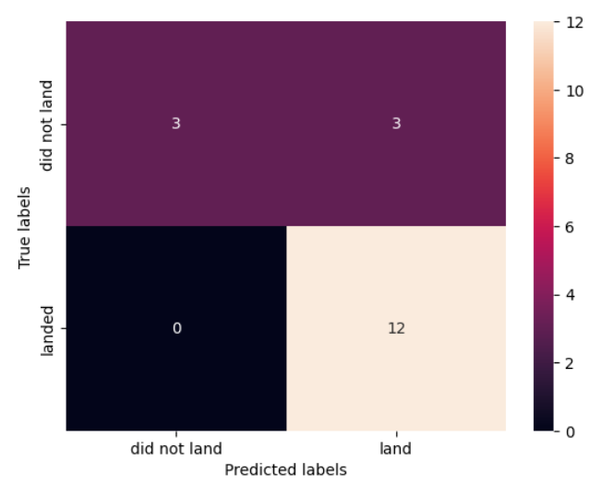
Predictive analysis confusion matrices
Logistic Regression
Support Vector Machines

Slide 24
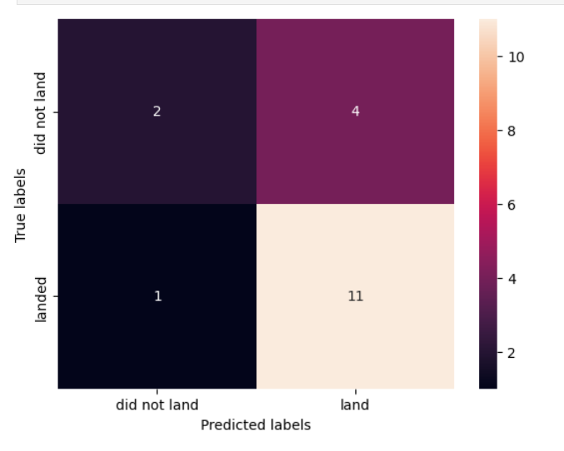
Predictive analysis confusion matrices cont.
Decision Tree Classifier Confusion Matrix
K-Nearest Neighbors

Slide 25
Results
Exploratory data analysis results
Interactive analytics demo in screenshots
Predictive analysis results

Slide 26

Section 2

Slide 27
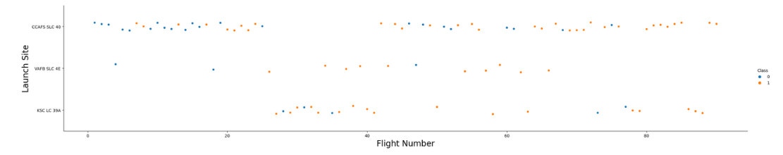
Flight Number vs. Launch Site
We can see that VAFB stopped running launches after the 60th flight number. We can also see that CCAFS had a
Higher success rate later on than in the beginning. This is noted by how may orange circles there are in higher
Flight numbers relative to smaller flight numbers.

Slide 28
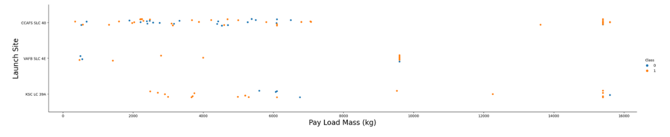
Payload vs. Launch Site

Slide 29
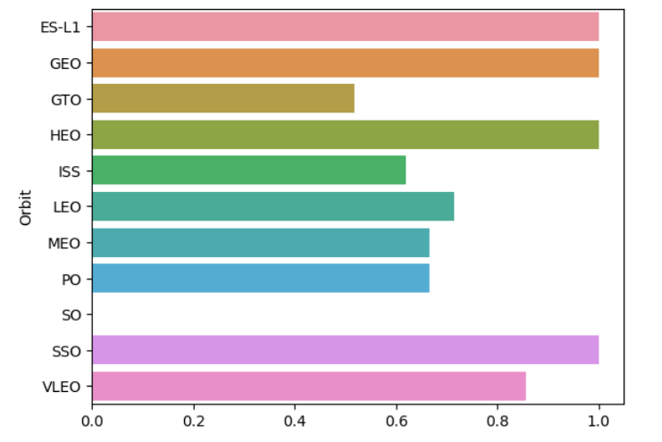
Success Rate vs. Orbit Type

Slide 30
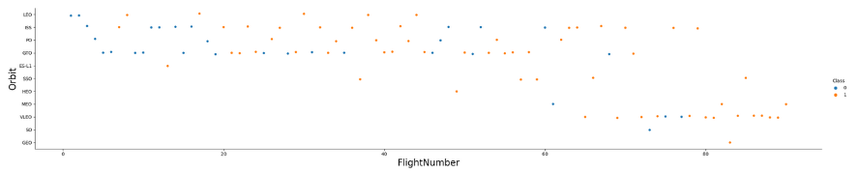
Flight Number vs. Orbit Type

Slide 31
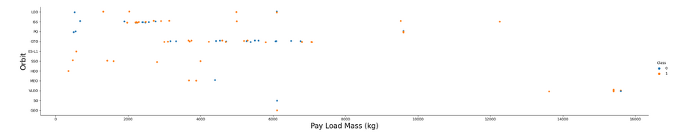
Payload vs. Orbit Type

Slide 32
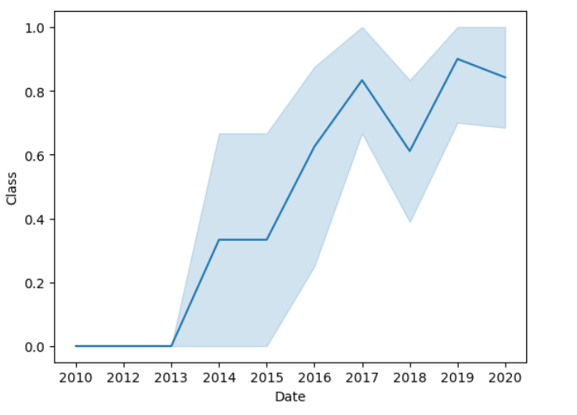
Launch Success Yearly Trend

Slide 33
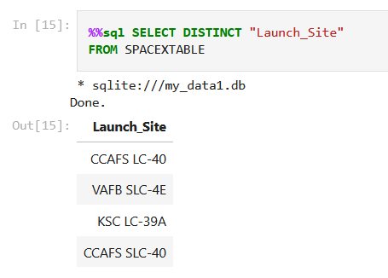
All Launch Site Names

Slide 34
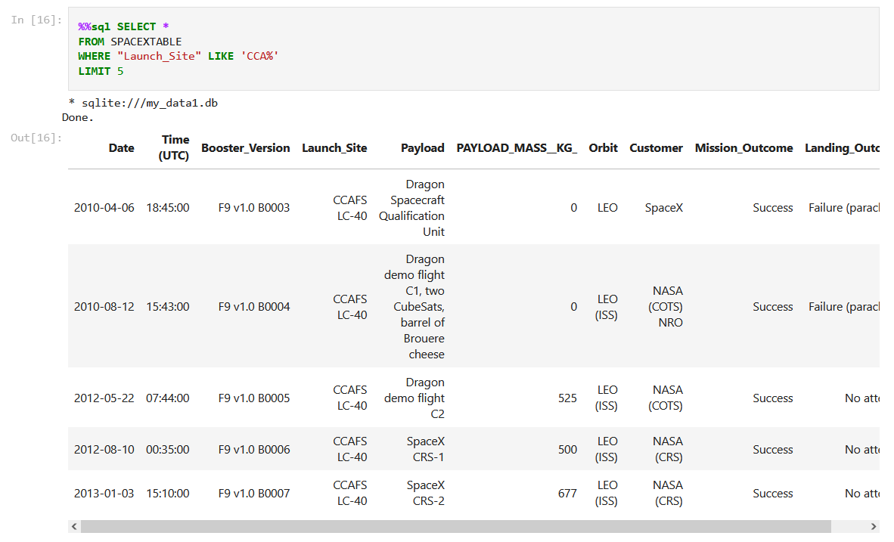
Launch Site Names Begin with 'CCA'

Slide 35
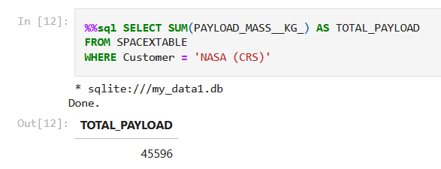
Total Payload Mass

Slide 36
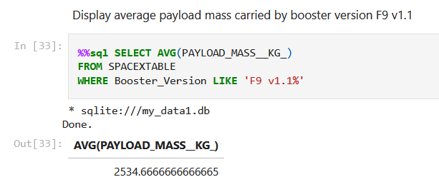
Average Payload Mass by F9 v1.1

Slide 37
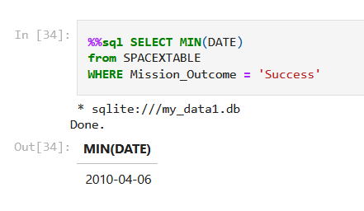
First Successful Ground Landing Date

Slide 38
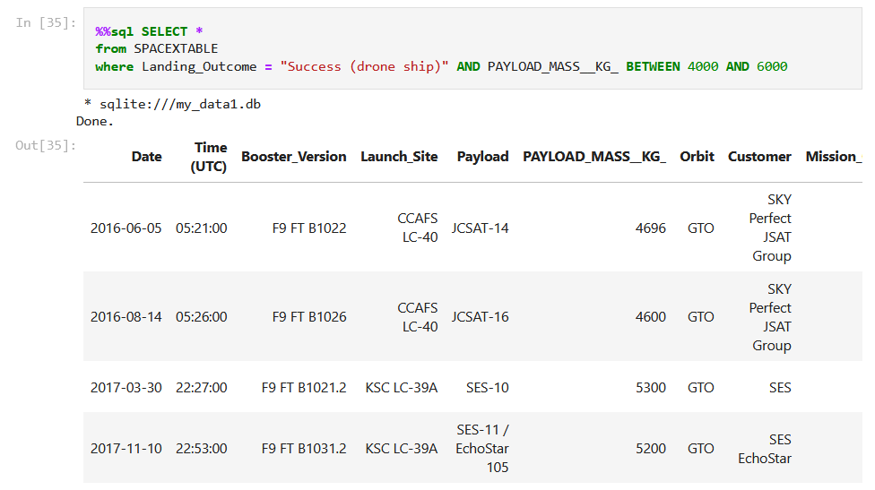
Successful Drone Ship Landing with Payload between 4000 and 6000

Slide 39
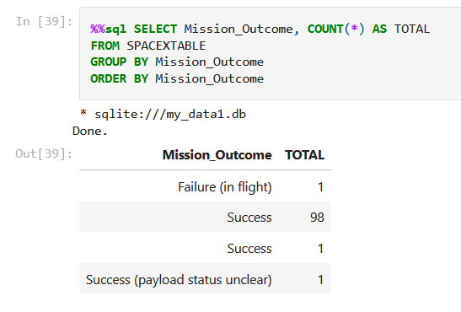
Total Number of Successful and Failure Mission Outcomes

Slide 40
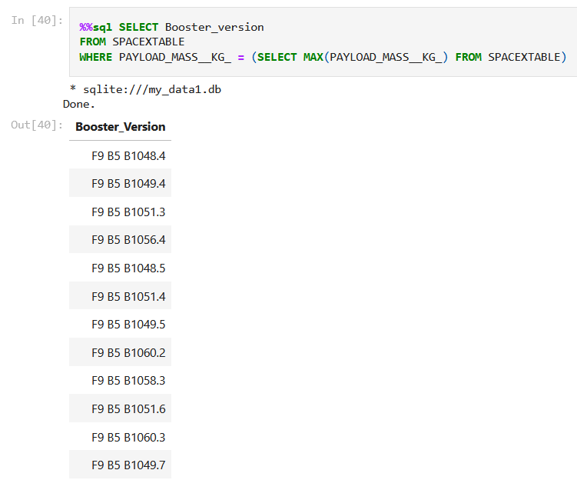
Boosters Carried Maximum Payload

Slide 41
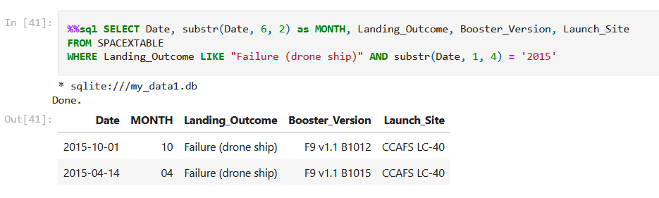
2015 Launch Records

Slide 42
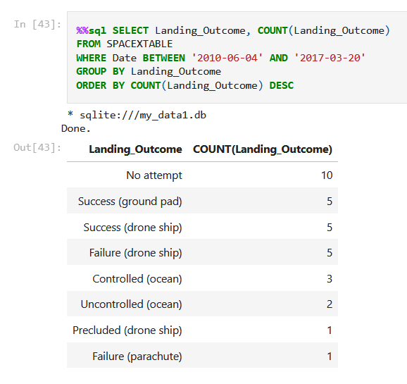
Rank Landing Outcomes Between 2010-06-04 and 2017-03-20

Slide 43

Section 3

Slide 44
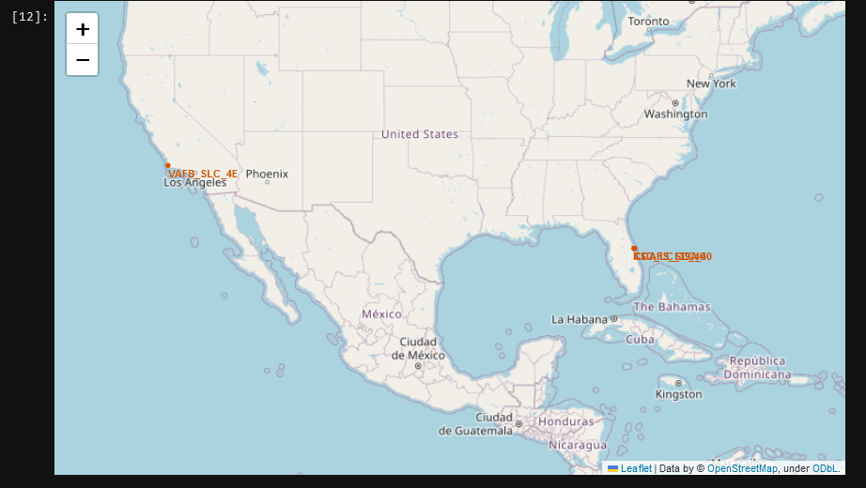
SpaceX Launch Site Locations - Folium
Launch site location
Launch site location
This Folium map shows the launch site locations that SpaceX used to launch its Falcon 9 rockets.
You can see that some of them were launched near Los Angeles, but most launch site locations are located in Florida.

Slide 45
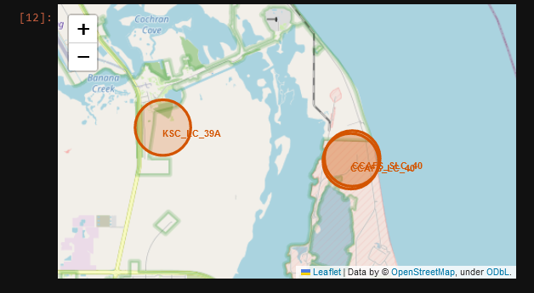
SpaceX Launch Site Locations - Folium
Launch site location
Launch site location
When zooming in on the state of Florida, we can see three launch site locations labeled with a red circle on the map. Two of them are stacked on top of each other on the right side of the Folium map.

Slide 46
<Folium Map Screenshot 2>
Replace <Folium map screenshot 2> title with an appropriate title
Explore the folium map and make a proper screenshot to show the color-labeled launch outcomes on the map
Explain the important elements and findings on the screenshot

Slide 47
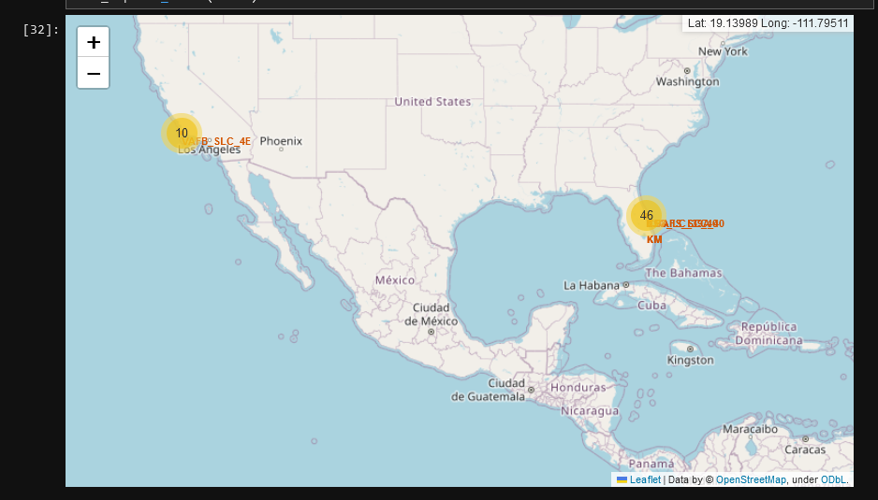
SpaceX Launch Outcome Locations - Folium

Slide 48
SpaceX Launch Outcome Locations – Folium cont.

Slide 49
<Folium Map Screenshot 3>
Replace <Folium map screenshot 3> title with an appropriate title
Explore the generated folium map and show the screenshot of a selected launch site to its proximities such as railway, highway, coastline, with distance calculated and displayed
Explain the important elements and findings on the screenshot

Slide 50
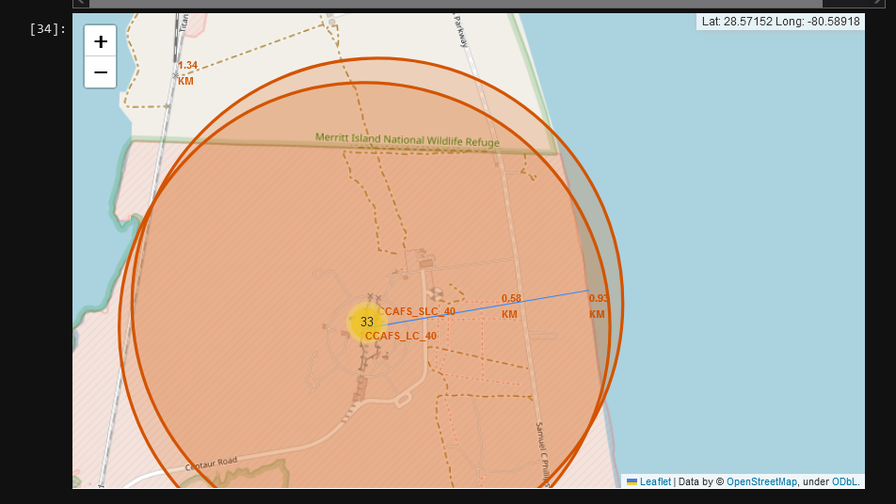
<Folium Map Screenshot 3>

Slide 51

Section 4

Slide 52
<Dashboard Screenshot 1>
Replace <Dashboard screenshot 1> title with an appropriate title
Show the screenshot of launch success count for all sites, in a piechart
Explain the important elements and findings on the screenshot

Slide 53
<Dashboard Screenshot 1>
Replace <Dashboard screenshot 1> title with an appropriate title
Show the screenshot of launch success count for all sites, in a piechart
Explain the important elements and findings on the screenshot

Slide 54
<Dashboard Screenshot 2>
Replace <Dashboard screenshot 2> title with an appropriate title
Show the screenshot of the piechart for the launch site with highest launch success ratio
Explain the important elements and findings on the screenshot

Slide 55
<Dashboard Screenshot 2>
Replace <Dashboard screenshot 2> title with an appropriate title
Show the screenshot of the piechart for the launch site with highest launch success ratio
Explain the important elements and findings on the screenshot

Slide 56
<Dashboard Screenshot 3>
Replace <Dashboard screenshot 3> title with an appropriate title
Show screenshots of Payload vs. Launch Outcome scatter plot for all sites, with different payload selected in the range slider
Explain the important elements and findings on the screenshot, such as which payload range or booster version have the largest success rate, etc.

Slide 57
<Dashboard Screenshot 3>
Replace <Dashboard screenshot 3> title with an appropriate title
Show screenshots of Payload vs. Launch Outcome scatter plot for all sites, with different payload selected in the range slider
Explain the important elements and findings on the screenshot, such as which payload range or booster version have the largest success rate, etc.

Slide 58

Section 5

Slide 59
Classification Accuracy
Visualize the built model accuracy for all built classification models, in a bar chart
Find which model has the highest classification accuracy

Slide 60
Classification Accuracy
Visualize the built model accuracy for all built classification models, in a bar chart
Find which model has the highest classification accuracy

Slide 61
Confusion Matrix
Show the confusion matrix of the best performing model with an explanation

Slide 62
Confusion Matrix
Show the confusion matrix of the best performing model with an explanation

Slide 63
Conclusions
Point 1
Point 2
Point 3
Point 4
…

Slide 64
Appendix
Include any relevant assets like Python code snippets, SQL queries, charts, Notebook outputs, or data sets that you may have created during this project

Slide 65


